Slide 1
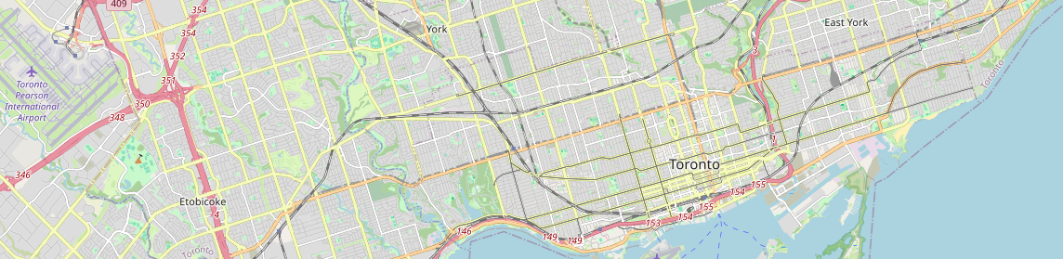
Traffic Incident Prediction and Analysis
April.06.2025
Senior Engineering Project Presentation
Group #3: Austin Perry - Duc Nguyen - Raish Khaitu

Slide 2
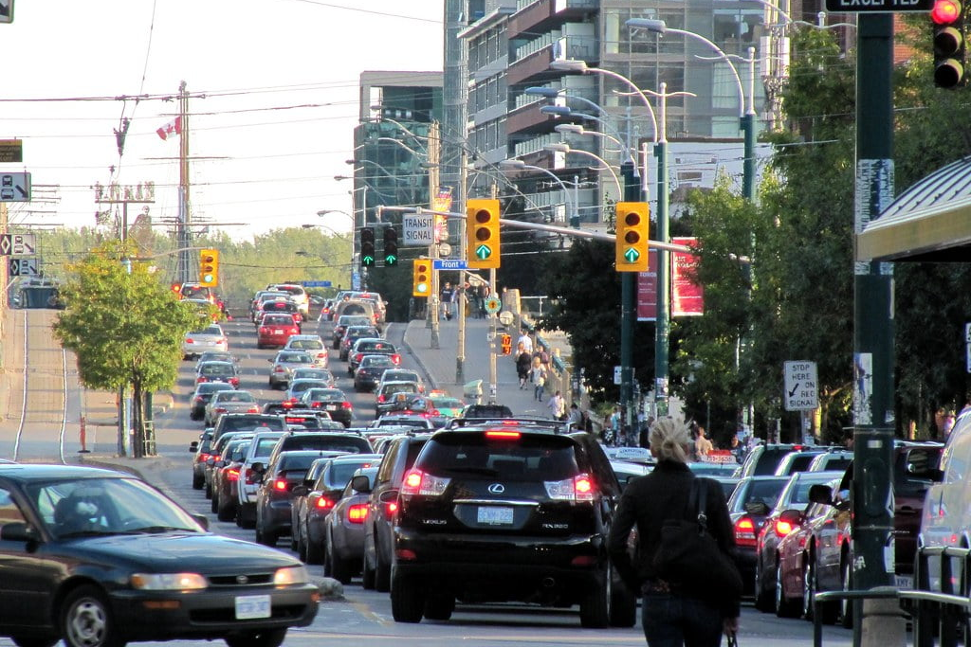
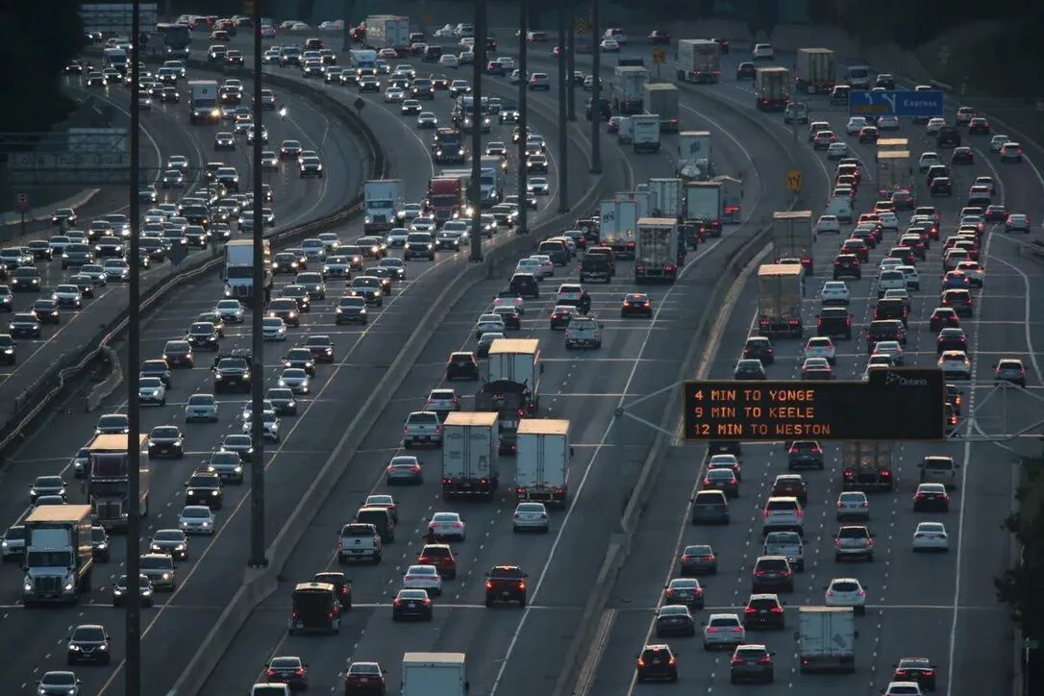
Introduction
Group 3
Traffic congestion and road incidents:
Impact millions daily
Cause unnecessary risk
Time spent sitting in traffic

Slide 3

Our Objective:
Group 3
Build a predictive navigation system based on:
Historical Collision Traffic Data
Real-time traffic data source
Collision Score Ratings

Slide 4
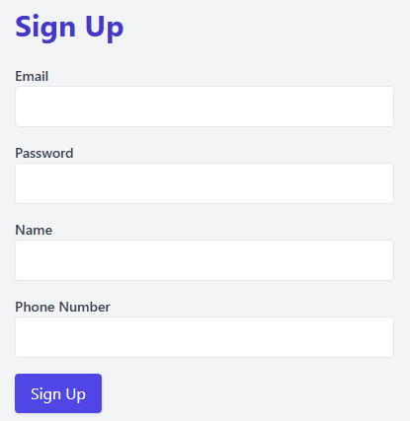
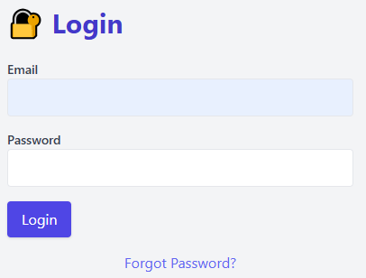
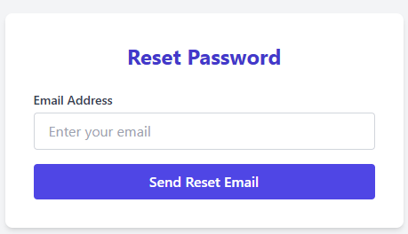
Front End:
Group 3
Intuitive User interface with:
CRUD User authentication implementation
Account recovery
Implemented JavaScript to capture form data in the Login page authentication endpoint with session tokens

Slide 5
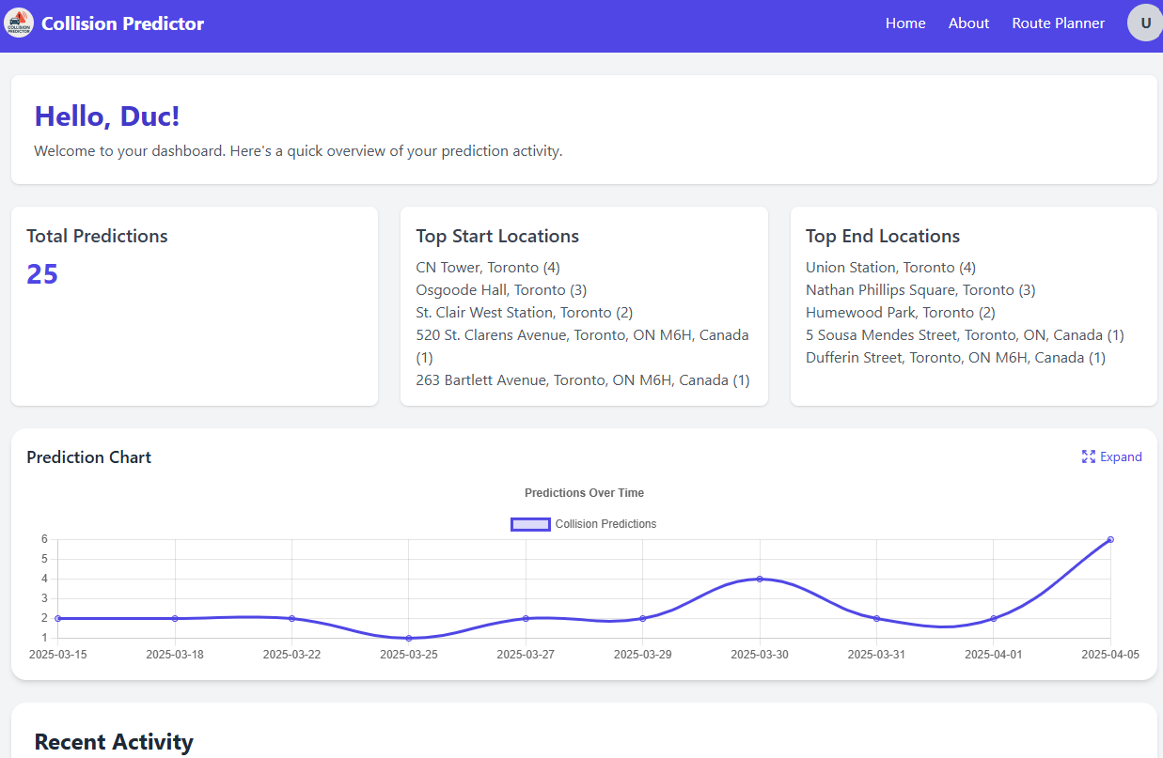

Front End:
Group 3
User route search history
Start and End locations
When our services were used

Slide 6
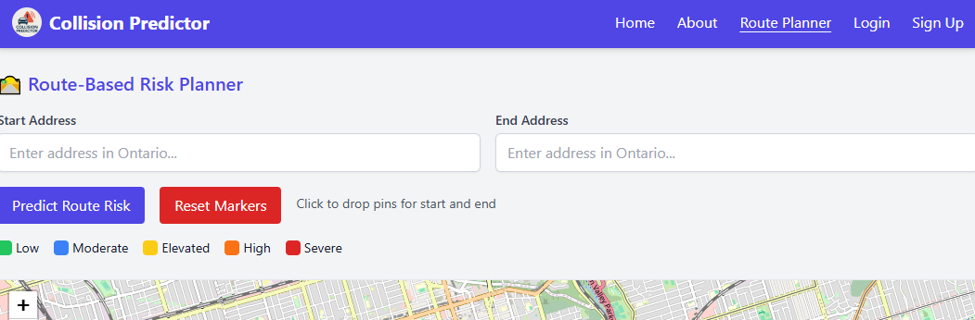
Front End:
Group 3
Interactive and Intuitive Map layout with TailWind css:
Start and end fields
Location drop markings
Multiple roads suggestions and informative display

Slide 7
Back End:
Group 3
Flask API handles user input data requests and return predictions
CORS (Cross-Origin Resource Sharing) for front-back end communications, sending and retrieving
Processed and cleaned historical traffic data from the Toronto Police GeoJSON dataset.
User Authentication and Data Modelling with python scripts
Implemented a /predict API endpoint that:
Accepts user data.
Processes it into a format the model understands.
Returns a prediction on whether a collision is likely to result in injuries.

Slide 8
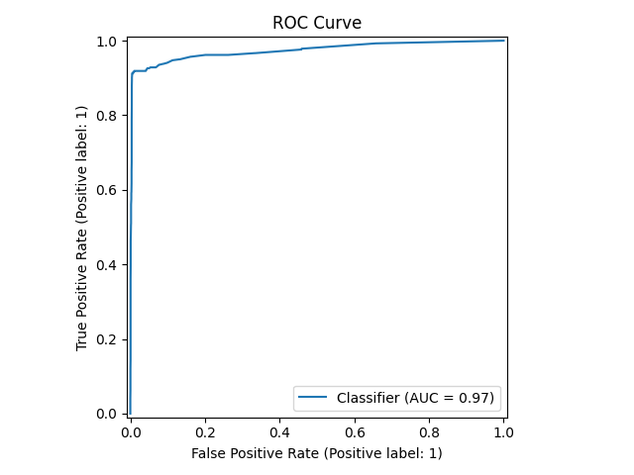
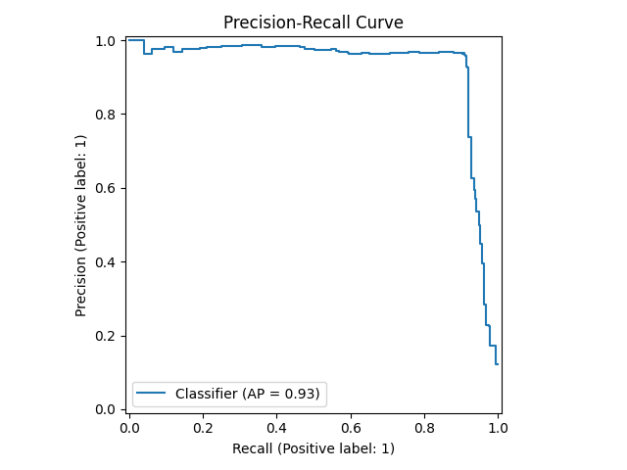
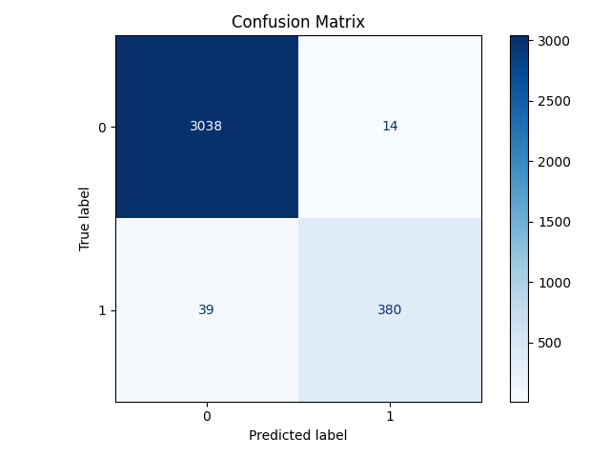
Back End:
Group 3
Trained a Random Forest machine learning model to predict injury collisions

Slide 9
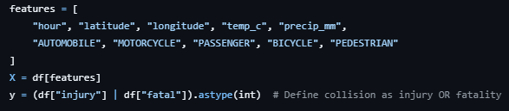
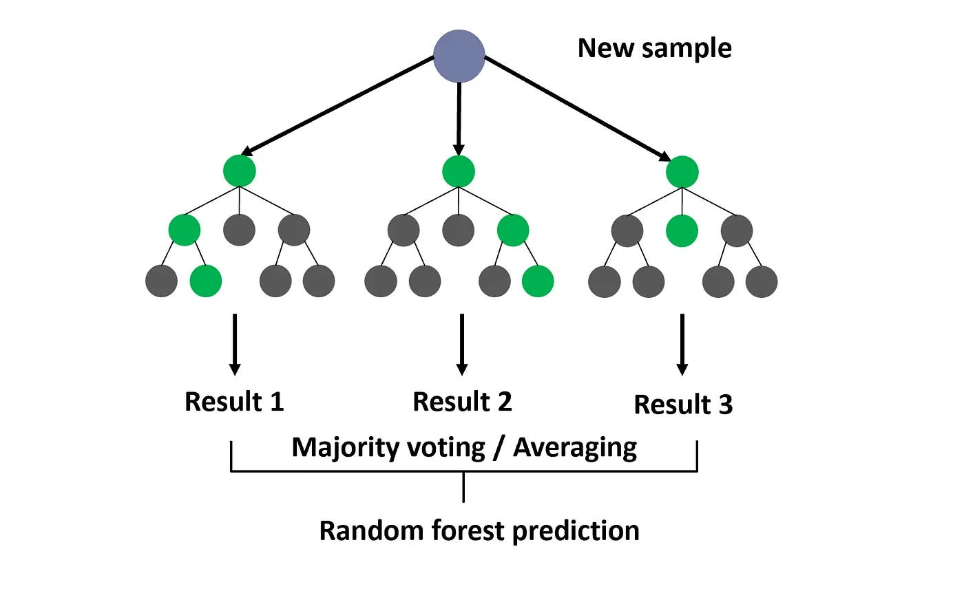
Back End:
Group 3
train_model.py:

Slide 10
Back End:
Group 3
How Risk Score is perceived:
Point A to B generated a score of 4.14 for that route.
Doesn’t mean you will crash 4 times for that specified route
Factors affecting the calculations:
Weather
Time
Location
It is a Predictive risk score, not a GUARANTEE!

Slide 11
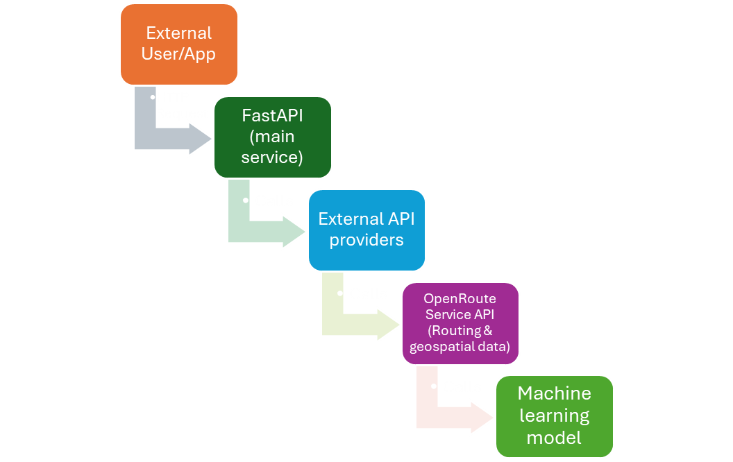
System Architecture:
Group 3

Slide 12
Tasks set out:
Group 3
Research and Planning | Completed
Data Collection and Preprocessing Traffic datasets from open sources (like city API’s) | Completed
Exploratory Data Analysis: Analyze data trends (traffic volume and incident patterns) | Completed
Model Selection and Development: Evaluate initial results and refine feature selection | Completed
Backend Development | Completed
Visualization Dashboard Development | Completed
Testing and Validation | Completed
System Integration | Completed

Slide 13
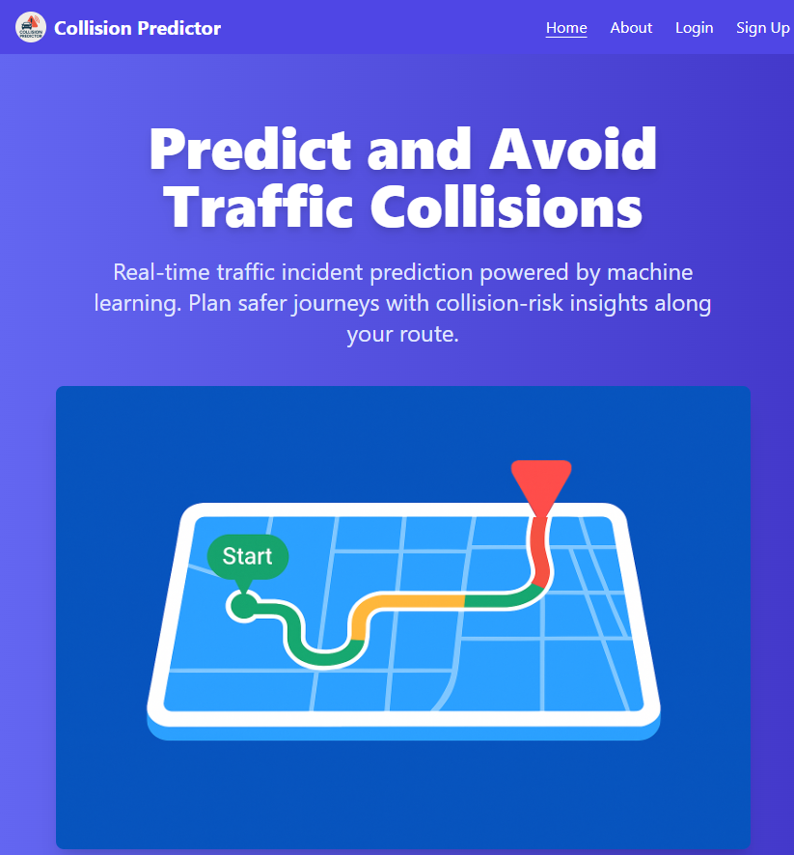
Live Demonstration
Live website and authentication, hosted by Raish at address: traffic.khaitu.ca
Group 3
Account Management
Map Application
Prediction Scores

Slide 14
Ethics & Sustainability:
Group 3
Account integrity with strict user password at creation
Clear and transparent routing algorithm
Data Privacy
Trustworthy historical data source taken from City of Toronto website
Promote road safety by highlighting the road with the least collision score
Environmentally-friendly by suggesting the most efficient route, minimizing the carbon footprint
Users provided with functioning models, reducing computational requirements

Slide 15
Q & A
Group 3
April.06.2025
Senior Engineering Project Presentation
Group #3: Austin Perry - Duc Nguyen - Raish Khaitu

Slide 16
Project Work:
Group 3
Tasks | Raish | Austin | Duc
Data Collection & Preprocessing:
Examining Toronto Police Traffic Collision dataset |  |  | X
Cleaning up the data (e.g. missing values, rows filtering) |  | X
Extracting relevant GeoJSON features and Exploratory Data Analysis using pandas/geopandas | X | X
Backend API Development:
Setting up the Flask Server | X
Writing and testing API routes for ML and User Navigation | X |  | X
Debugging CORS issues with frontend-backend communication | X | X
Discussing and refining user authentication and navigation | X | X | X

Slide 17
Project Work:
Group 3
Tasks | Raish | Austin | Duc
Frontend Development:
Designing and Writing user Interface Pages | X |  | X
Testing Javascript logic that communicates with backend | X | X
Building the Mapbox UI and API integration for route and incident visualization and Testing | X | X | X
Styling with TailWind css for a unified and modern look | X | X
Authentication and User Management:
Create hardcoded Login prototype |  | X | X
Upgrading to Signup/Login forms with full fields |  | X | X
Design and implement Profile Dashboard | X

Slide 18
Project Work:
Group 3
Tasks | Raish | Austin | Duc
Enforcing User validations such as password length and prevent duplicate usernames | X | X
Implement local Storage-based session and user access control | X |  | X
Testing and Debugging:
Testing Predictions via the frontend form and model output |  | X | X
Debugging frontend-backend Integration issues | X
Verifying routing logic and Mapbox display | X | X
Validate and Debug Signup, Login, Profile Update and Delete functionality | X | X | X

